Slide 1

Data Preprocessing Plan
DATA71011 Understanding Data & their Environment
Group: Violet

Slide 2
Contents
Data Preparation
Data Exploration
Handling Missing Data
Noise Identification & Data Cleaning
Data Linkage
Feature Engineering
Data Transformation
Data Normalisation

Slide 3
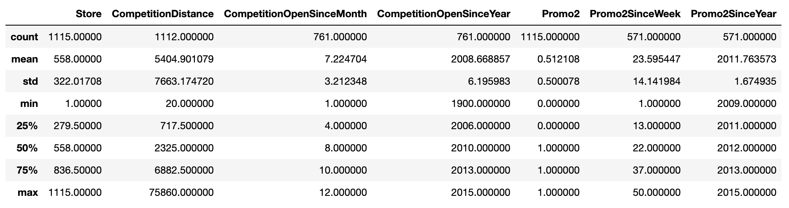
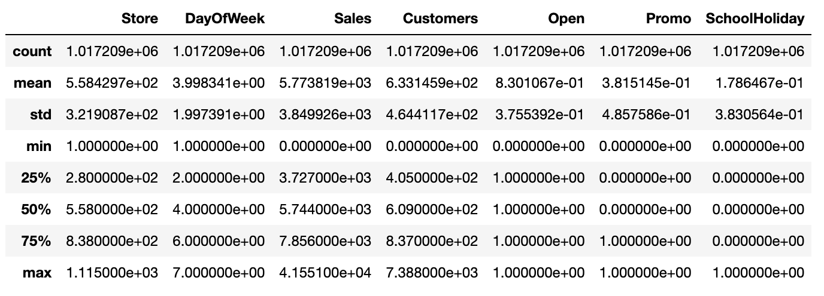
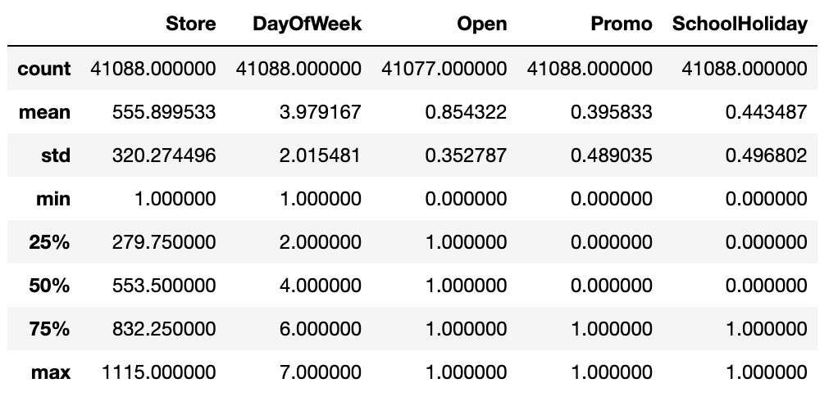
Data Exploration - Statistics
stores.csv
train.csv
test.csv

Slide 4
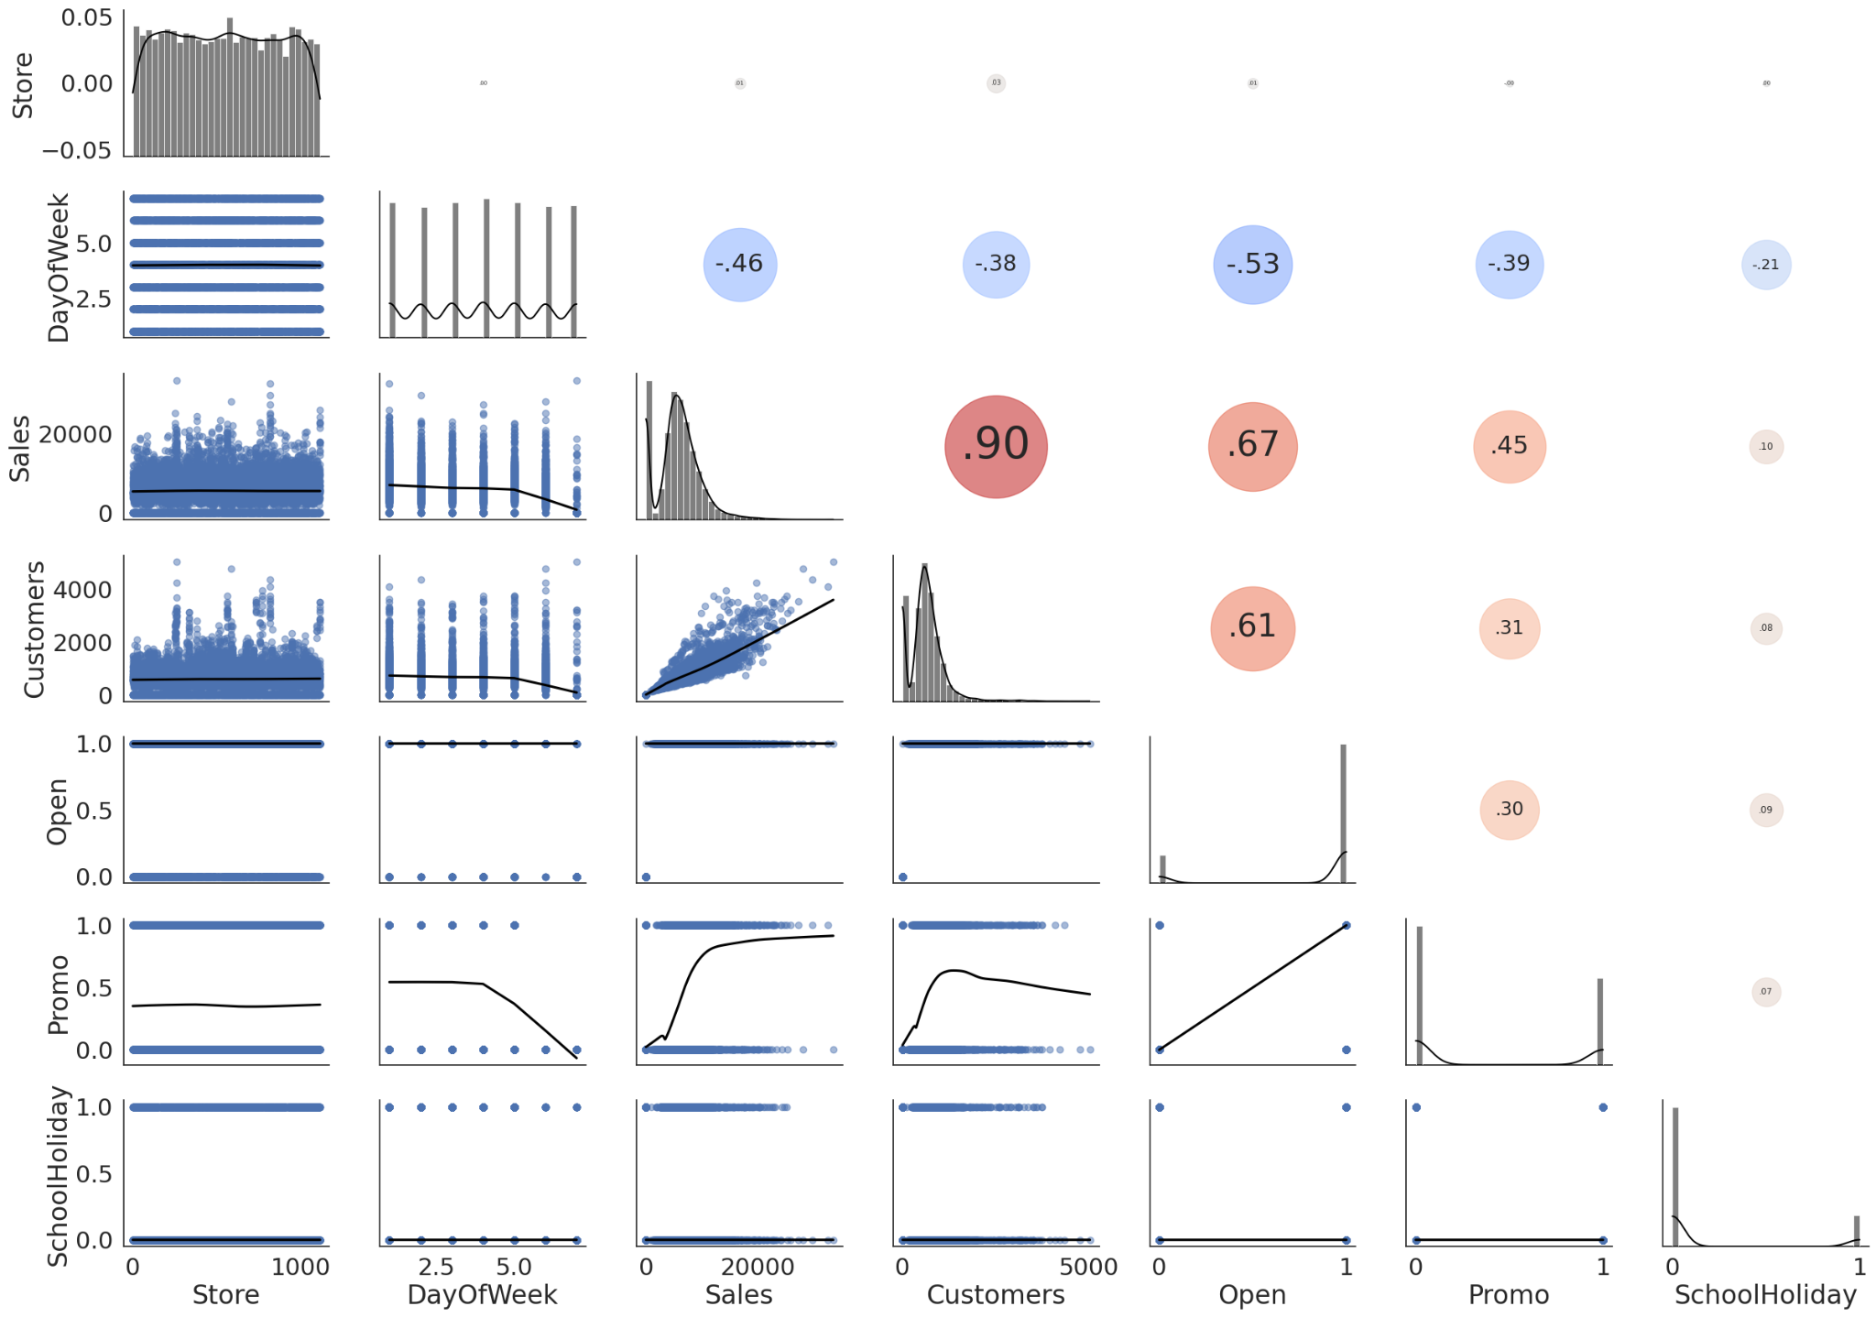
Data Exploration - EDA
3000 samples from train.csv

Slide 5
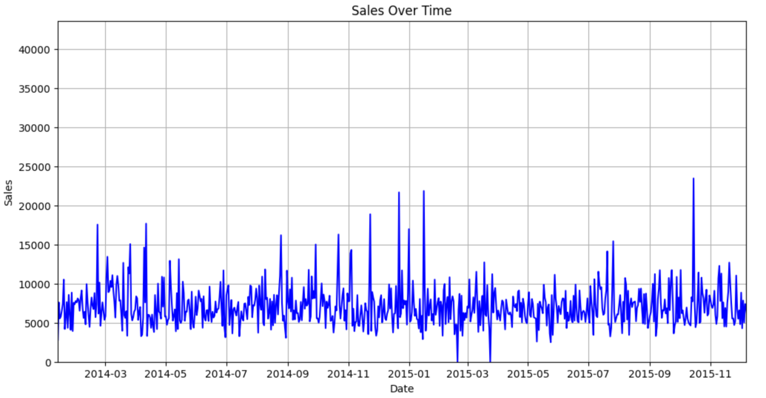
Data Exploration - EDA

Slide 6
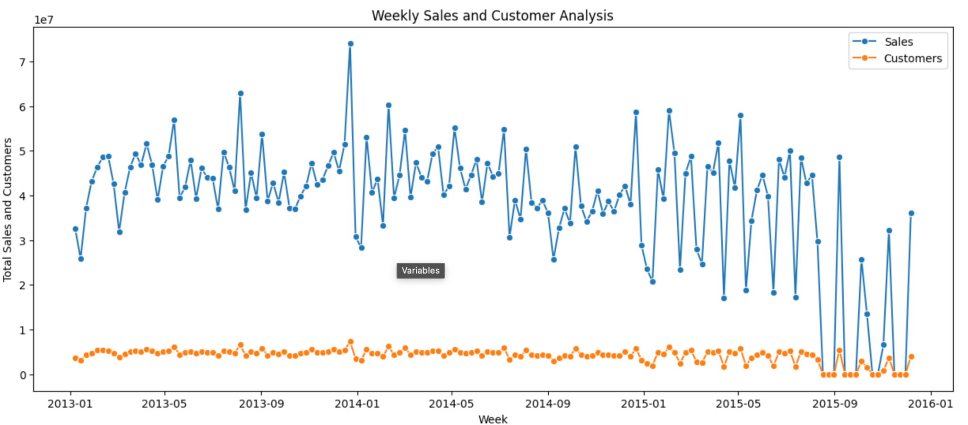
Data Exploration - EDA

Slide 7
Handling Missing Data
Train.csv and Test.csv - No Missing Values
Stores.csv
Attributes | Missing Count
Store | 0
StoreType | 0
Assortment | 0
CompetitionDistance | 3
CompetitionOpenSinceMonth | 354
CompetitionOpenSinceYear | 354
Attributes | Missing Count
Promo2 | 0
Promo2SinceWeek | 544
Promo2SinceYear | 544
PromoInterval | 544
Missing Completely At Random
Missing Not At Random

Slide 8
Noise Identification & Data Cleaning
- Check for completeness, accuracy and consistency
Completeness
There are missing values in Stores.csv.
How to handle missing time-series values?
Accuracy
There are “outliers” in data.
We decided not to remove these values, since it's historical data and we need to keep all instances.
Consistency
The data adheres to expected values/format.

Slide 9
Data Linkage
- Link train.csv & stores.csv and test.csv & stores.csv
In order to keep consistency across training and testing the model, we linked stores.csv to both datasets
Linked on common attribute 'Store', using an inner join.
Code for merging datasets

Slide 10
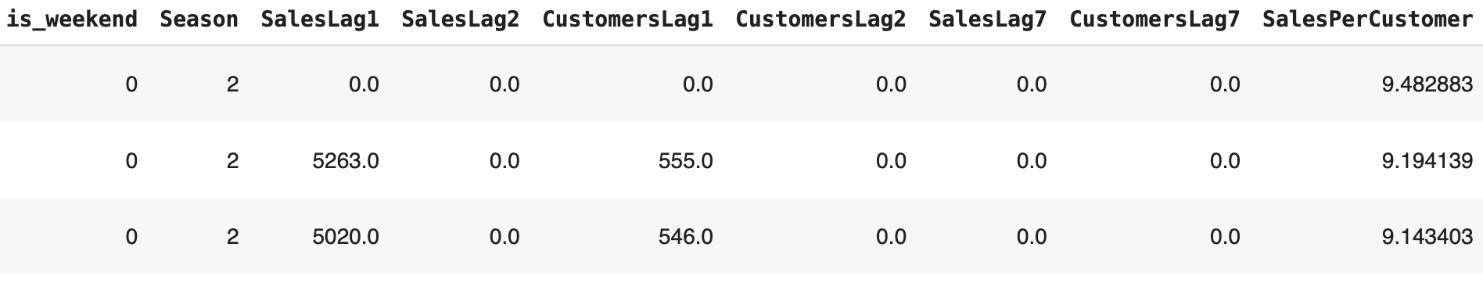
Feature Engineering
- Creating new indicators/variables:
Temporal features
Extracting features from Date - Month, Year, Weekends
Seasonal Features - Winter, Spring, Summer, Fall.
Lag Features - SalesLag1 & SalesLag7 + CustomersLag1 & CustomersLag7
Customer-related features
Sales per Customer
Average Sales per Month

Slide 11
Data Transformation
- Encoding categorical variables into numerical variables:
Label Encoding
StoreType
AssortmentLevel
PromoInterval
Season

Slide 12
Data Normalisation
- Depends on data distribution and the algorithm used for modelling:
Most likely will apply Standard Scaling
specified attributes will have zero mean and unit variance.
*At this point, we cannot select a specific normalisation technique as we have not yet reached the modelling stage.

Slide 13




Feature Selection
- Select the highly correlated variables for model training/fitting:
Sales/Customers Lag
Open

